Slide 1


CAREER VISION APP
-SHAKTHI SRI S
-SARAH JACI J
~ BATCH NO:06

Slide 2

DOMAIN:
APP DEVELOPMENT

Slide 3
INTRODUCTION:-
The objective of our career web application is to guide the students towards their career. Through this app students will get a clear idea about the courses available in each college and their level of scope.In Addition to this ,our app also gives an analysis chart for each student based on their marks obtained, so that they will get a clear idea about their field of Knowledge. So by this way students need not depend on others for their guidance.

Slide 4
PROBLEM STATEMENT
Making career choices and counselling accessible to every child at secondary level along with clear views and detailed career paths

Slide 5
TECHNOLOGY USED
FLUTTER
DART
AGORA(for video conferencing)
Flutter is an open-source UI software development kit created by Google. It is used to develop cross platform applications for Android, iOS, Linux, macOS, Windows, Google Fuchsia, and the web from a single codebase.
Dart is a programming language designed for client development, such as for the web and mobile apps. It is developed by Google and can also be used to build server and desktop applications. Dart is an object-oriented, class-based, garbage-collected language with C-style syntax. Dart can compile to either native code or JavaScript. It supports interfaces, mixins, abstract classes, reified generics, and type inference.

Slide 6

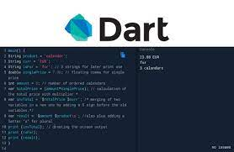
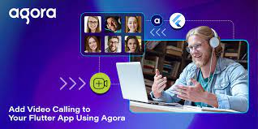

Contd….
Agora:- Large-scale events can be especially difficult to personalize, but Agora’s interactive live streaming SDKs make it easy for you to build apps with audio and video streaming that encourage real-time exchanges, creating deeper connections and driving revenue opportunities.

Slide 7
Existing System:
It just gives college details available …but it doesn’t give clear idea about the course details available in that particular college
We should search for different colleges in desired location on our own which is a tedious process
We should register in that website to access the details available which everybody don’t opt for
Students get guidance from other people for their future studies or job related information as they feel unsatisfactory about the details available in these kind of websites

Slide 8

Innovation of our project
Career Vision does career counselling in a new and innovative
method.
We offer a holistic view on career guidance through an excellent
online counselling.
Scope for each course and job opportunity details will be provided

Slide 9
Can connect with people in educational and industrial field to get clear guidance
Students from 8th standard to working professionals can get benefitted
by this app
One of the interesting feature which has been proposed in this system is→based on their marks obtained in their high school…clear analysis chart will be provided for the students to get a idea about their chances of opting for that course and college.

Slide 10
Social Relevance
Our app favors people in rural areas through video conferencing(agora)
People who doesn’t have clear knowledge about higher studies and future job opportunities get benefited through our application.
Students and other working professionals gain intelligible knowledge about the scope in each fields.

Slide 11
BLOCK DIAGRAM:
Application
Profile Creation
Analysis Chart
(based on marks)
Availability Of Courses
University Information(script)
Video Conferencing(agora)
Clear Vision

Slide 12
THANK YOU!!

